Slide 1
Jar Files
Distributing your code

Slide 2
Java Archive (JAR) files
Enables you to bundle multiple files into a single archive file. Typically a JAR file contains the class files and resources (ex. images) associated with an application or library
The JAR file format provides many benefits:
Portability: The mechanism for handling JAR files is a standard part of the Java platform's core API; compatible with all operating systems
Decreased download time: The class files and associated resources can be downloaded to a browser in a single HTTP transaction without the need for opening a new connection for each file
Compression: The JAR format allows you to compress your files for efficient storage
Package Sealing: Packages stored in JAR files can be optionally sealed so that the package can enforce version consistency. Sealing a package within a JAR file means that all classes defined in that package must be found in the same JAR file.
Security: You can digitally sign the contents of a JAR file. Users who recognize your signature can then optionally grant your software security privileges it wouldn't otherwise have
Package Versioning: A JAR file can hold data about the files it contains, such as vendor and version information

Slide 3
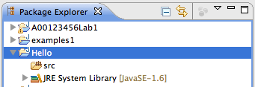
Creating Jar Files
Right-click on the Hello project folder
From the context menu, select Export…
From the dialog, select Runnable JAR file…
Press "Next"

Slide 4
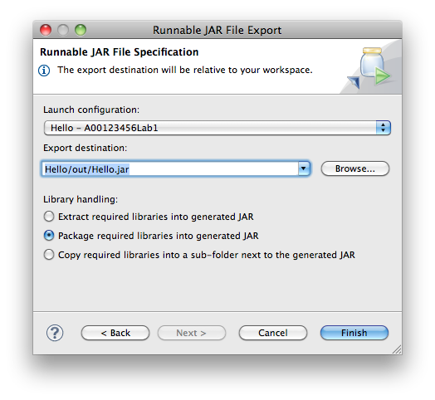
Creating Jar Files
Select a "Runnable Configuration"
You must have run the "main" class once for it to appear in the list
Select ”Hello - …."
Enter the output name
Click "Finish"

Slide 5
Creating Jar Files
Open a command shell
Change the working directory to where to saved the jar file
Run the jar
java -jar Hello.jar

Slide 6
> Try it…
Change your program to format any floating point value to a desired length
ex. 3.1415278 2 >>> 3.14
Hint, to convert a String value to a double:
Double.parseDouble(s)
and a String to an int
Integer.parseInt(s)

